Slide 1
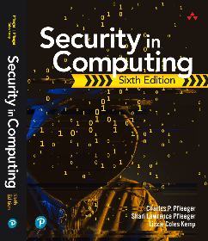
Security in Computing Sixth Edition
Charles P. Pfleeger
Shari Lawrence Pfleeger
Lizzie Coles-Kemp
Chapter 3: Programs and Programming

Slide 2
In This Chapter
Programming oversights: buffer overflows, incomplete mediation, time-of-check to time-of-use errors, off-by-one errors
Malicious code: viruses, worms, Trojan horses
Developer countermeasures: program development techniques, security principles
Ineffective countermeasures

Slide 3
Unintentional (Nonmalicious) Programming Oversights
A program flaw can be a fault affecting the correctness of the program’s result-that is, a fault can lead to a failure
Incorrect operation is an integrity failing
Even a flaw from a benign cause can be exploited by someone malicious

Slide 4
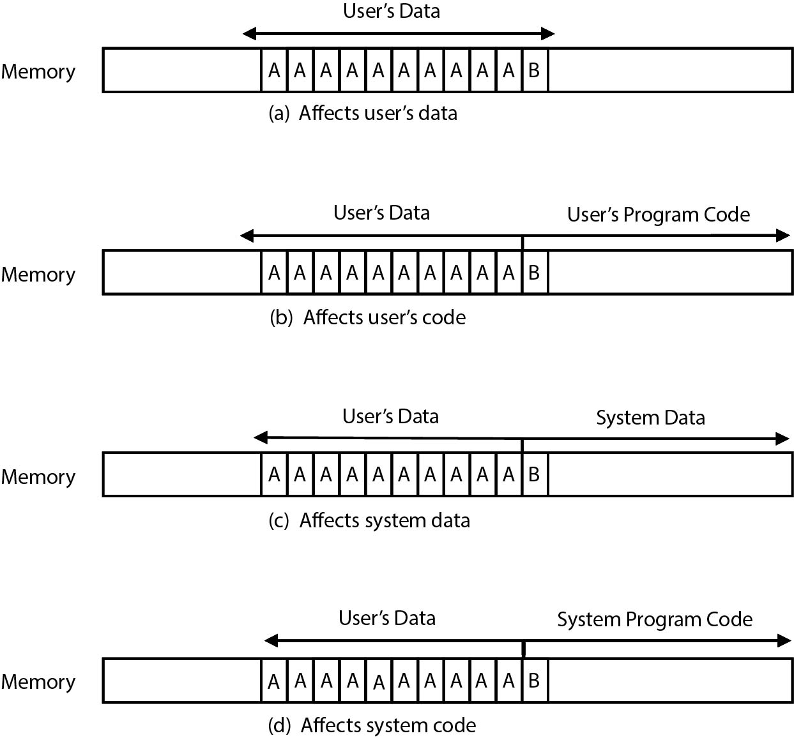
Buffer Overflow
Buffer overflows often come from innocent programmer oversights or failures to document and check for excessive data
FIGURE 3-4 One-Character Overflow

Slide 5
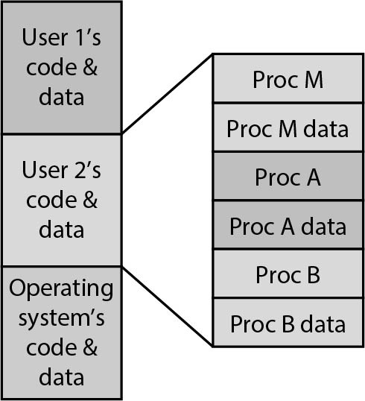
Buffer Overflow (cont'd)
Local data are stored adjacent to the code of a procedure
A data overflow either falls strictly within a data space or spills over into an adjacent code area
The data end up on top of one of the following:
Another piece of your data
An instruction of yours
Data or code belonging to another program
Data or code belonging to the operating system
FIGURE 3-5 Memory of Different Procedures for Different Users

Slide 6
Data-Driven Attack
Stack: Key data structure necessary for interchange of data between procedures
The attacker wants to overwrite stack memory, sometimes called stack smashing, in a purposeful manner
Ways the attacker can utilize an overflow attack:
Overwrite the program counter stored in the stack so that when this routine exits, control transfers to the address pointed at by the modified program counter address
Overwrite part of the code in low memory, substituting the attacker’s instructions for previous program statements
Overwrite the program counter and data in the stack so that the program counter now points into the stack, causing the data overwritten into the stack to be executed

Slide 7
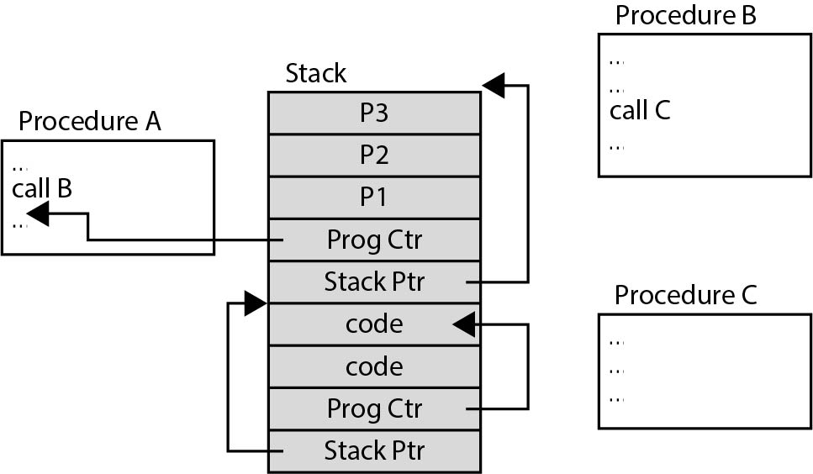
Example of a Compromised Stack
FIGURE 3-10 Compromised Stack

Slide 8
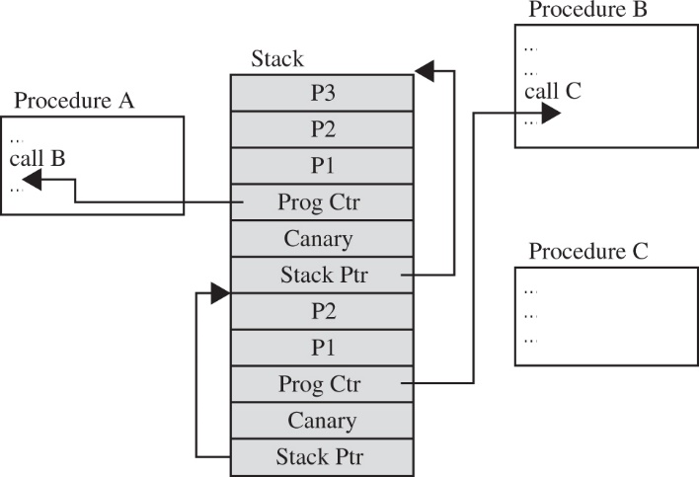
Countermeasures
Check before you write!
Programming controls:
Independent testing
Code review
Code analyzers
Separation
Stumbling blocks:
Canary layers
FIGURE 3-11 Canary Values to Signal Modification

Slide 9
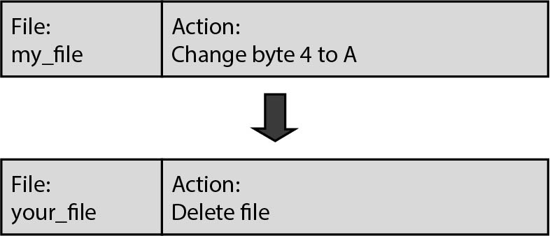
Time-Of-Check To Time-Of-Use (TOCTTOU)
Between access check and use, data must be protected against change to avoid hijacking of the data for other purposes
FIGURE 3-13 Unchecked Change to Work Descriptor

Slide 10
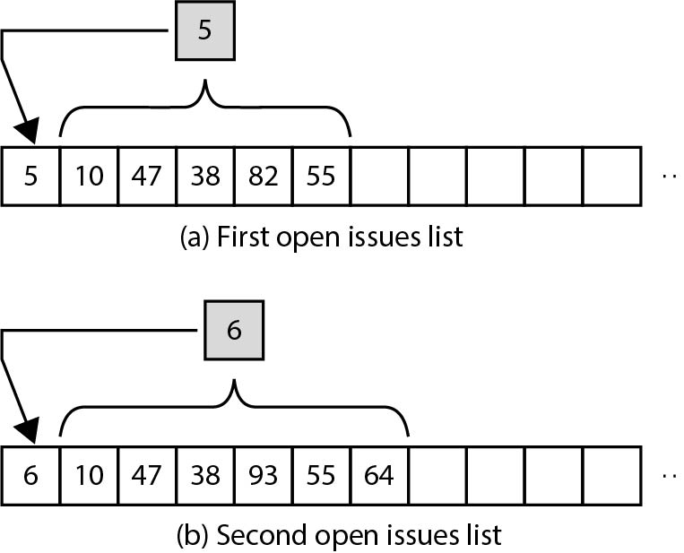
Off-by-One Error
Neophytes can easily fail with an off-by-one error:
miscalculating the condition to end a loop (repeat while i<=n or i<n? repeat until i=n or i>n?) or overlooking that an array of A[0] through A[n] contains n+1 elements
FIGURE 3-14 Both Data and Number of Used Cells in an Array

Slide 11
Malicious Code-Malware
Malicious code or rogue programs or malware:
Programs or program parts planted by an agent with malicious intent to cause unanticipated or undesired effects
The agent is the program’s writer or distributor
Virus:
Program that can replicate itself and pass on malicious code to other nonmalicious programs by modifying them
Transient virus
Resident virus

Slide 12
Malicious Code-Malware (cont'd)
Worm:
Program that spreads copies of itself through a network
Trojan horse:
Malicious code that, in addition to its primary effect, has a second, nonobvious, malicious effect
Bot (short for robot):
A kind of worm used by search engine hosts
Armies of bots run on any computers on which they can install themselves
They scan accessible web content continuously and report back to their controller any newly found content

Slide 13
Aspects of Malicious Code Infections
Harm: How they affect users and systems
Transmission and propagation: How they are transmitted and replicate, and how they cause further transmission
Activation: How they gain control and install themselves so that they can reactivate
Stealth: How they hide to avoid detection

Slide 14
Malicious Code Infections: Harm
Harm:
Nondestructive (including virus hoaxes)
Destructive
Commercial or criminal intent
Examples:
Deleting files, changing content, hiding cursor, forwarding emails or sensitive data

Slide 15
Transmission and Duplication
Setup and installer program transmission
Attached file
Document viruses
Autorun
Propagation
Appended viruses
Viruses that surround a program
Integrated viruses and replacements

Slide 16
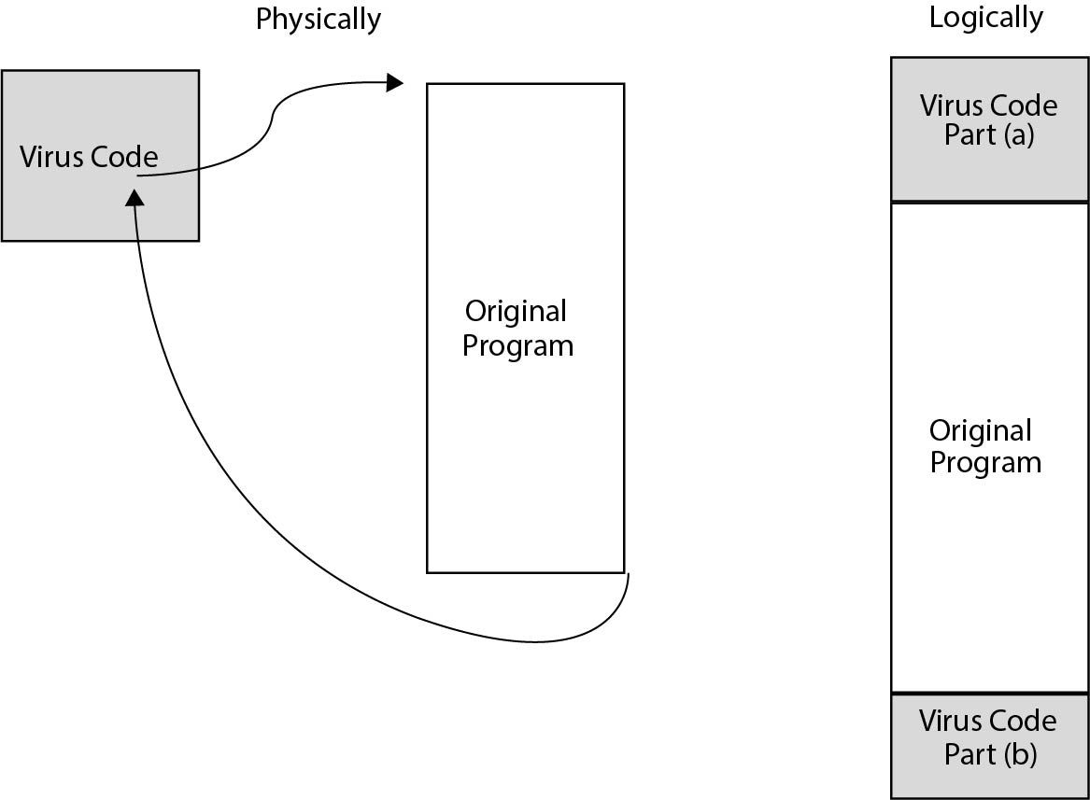
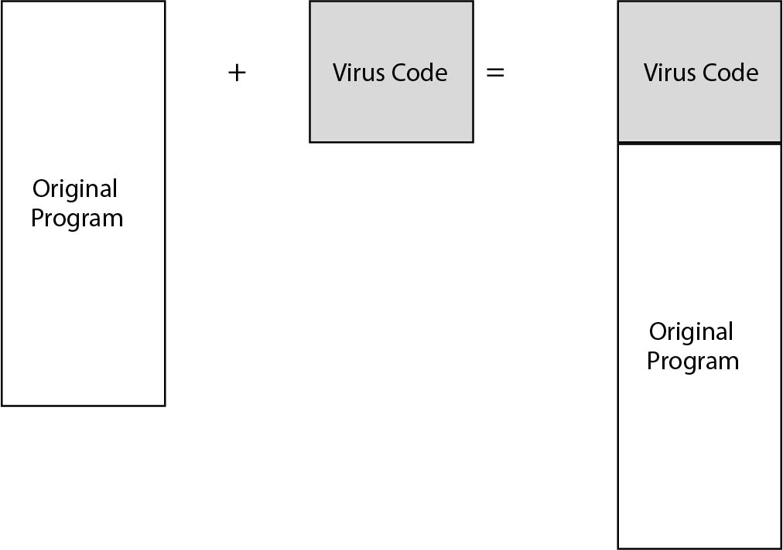
Examples of Viruses
FIGURE 3-19 Virus Attachment
FIGURE 3-20 Surrounding Virus

Slide 17
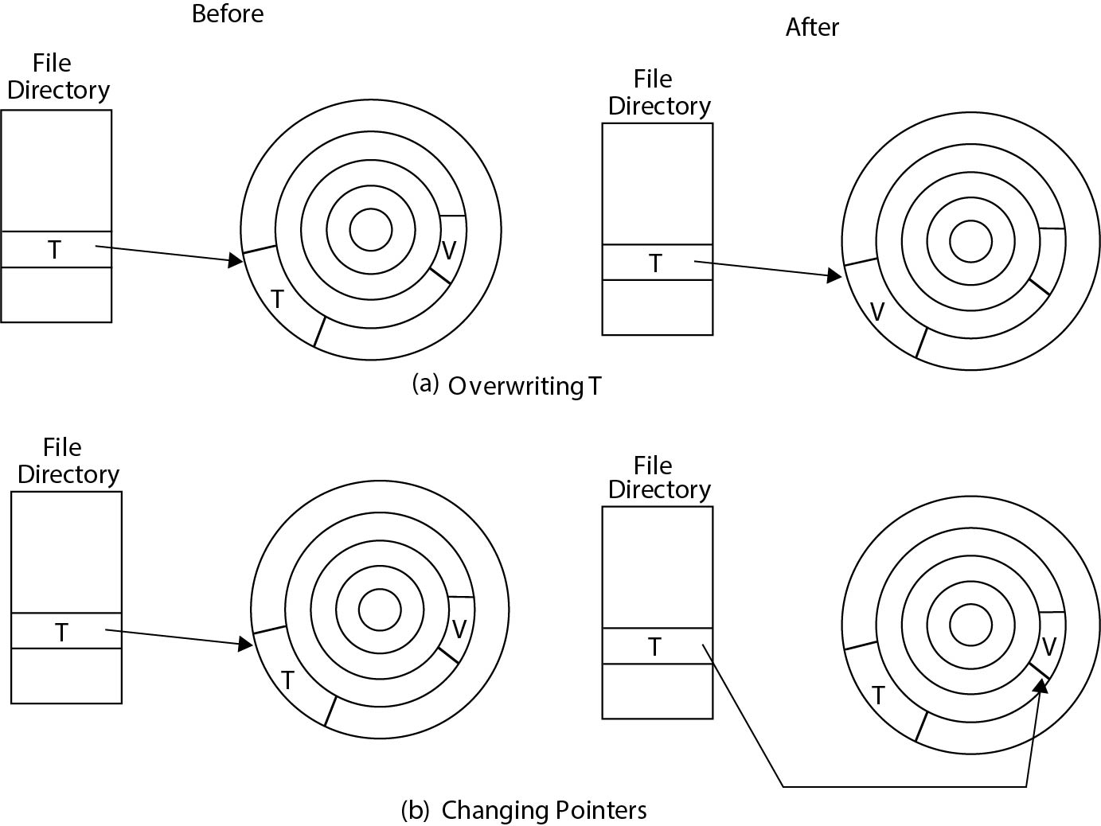
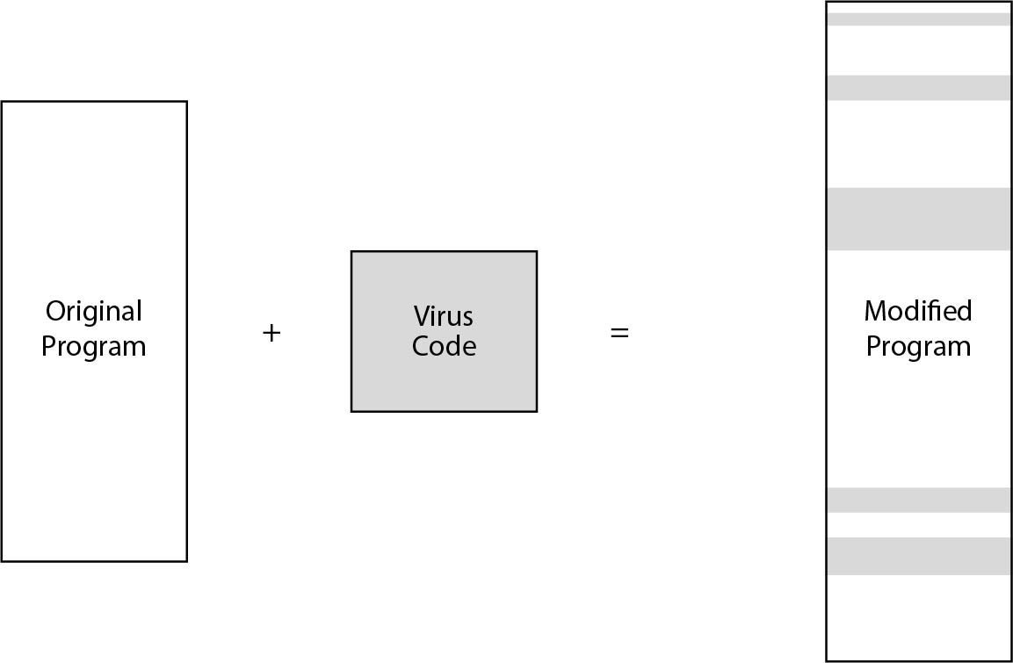
Examples of Viruses (cont'd)s
FIGURE 3-21 Virus Insertion
FIGURE 3-22 Virus V Replacing Target T

Slide 18
Homes for Viruses
Embedding
One-time execution (implanting)
Boot-sector viruses
Memory-resident viruses
Application programs

Slide 19
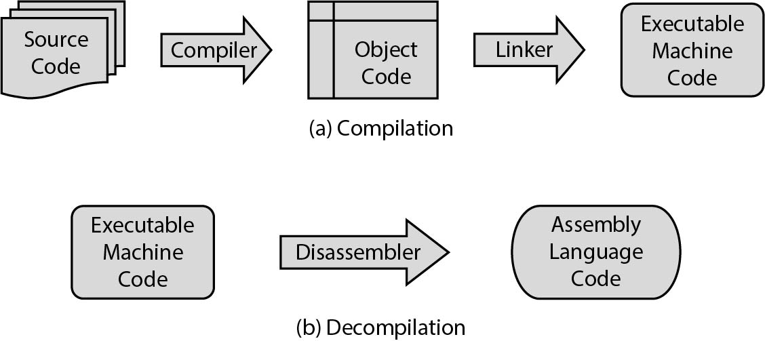
Countermeasures
Avoiding points of contamination and blocking avenues of vulnerability during the entire process
FIGURE 3-24 The Compilation Process: (a) Compilation (b) Decompilation

Slide 20
Summary
Programmer errors
Exploitation of vulnerabilities by hackers
Exploration of transmission of malicious code
Effective countermeasures

